Slide 1
SonarQube System Report
Team 2
Đỗ Hùng Cường
Nguyễn Nhật Quang
Nguyễn Hải Triều
Hà Xuân Đạt

Slide 2
Content
About Requirement and SonarQube
SonarQube System Report
System Architecture
Project Demo

Slide 3
About Requirement and SonarQube

Slide 4
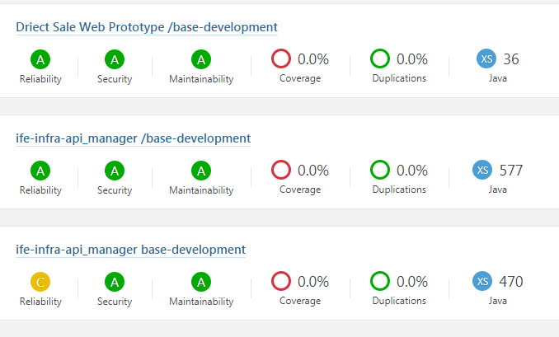
About SonarQube and Requirement

Slide 5
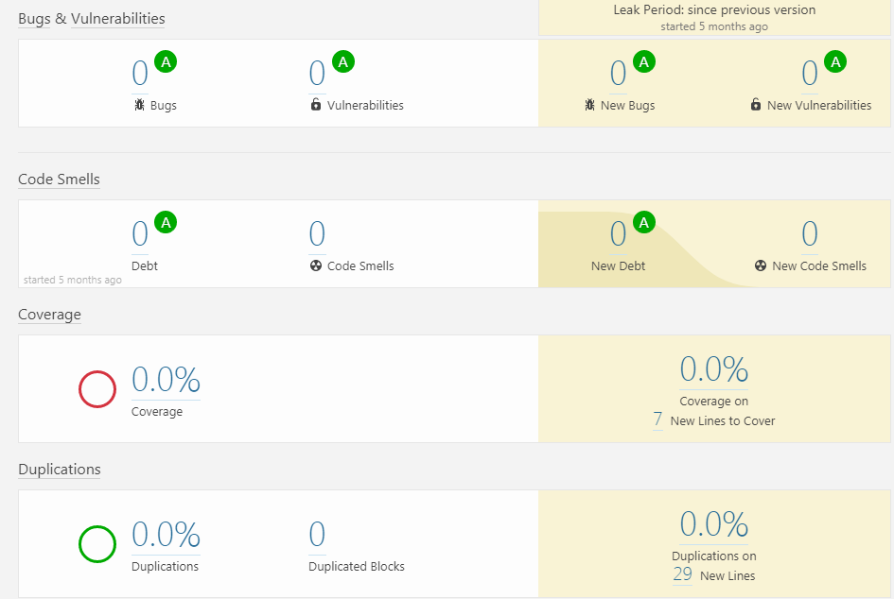
About SonarQube and Requirement

Slide 6
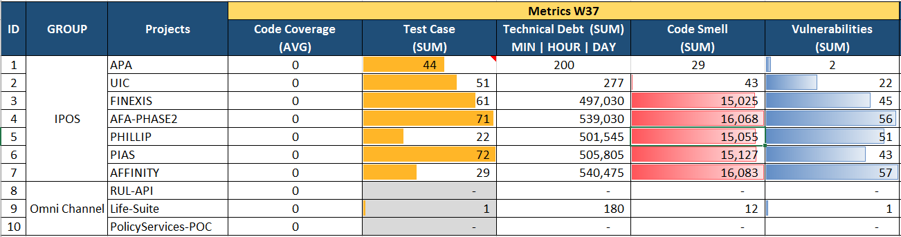
About Requirement and SonarQube
Requirement
As a user, I want to view report from SonarQube system. The report includes the following information: total unit testcases, total technical debts, total code smells, vulnerabilities. And, I also can see daily or weekly histories of every items of every project has occurred in the most recent four weeks. The history data can be represented by line chart or any suitable chart.

Slide 7
SonarQube System Report

Slide 8
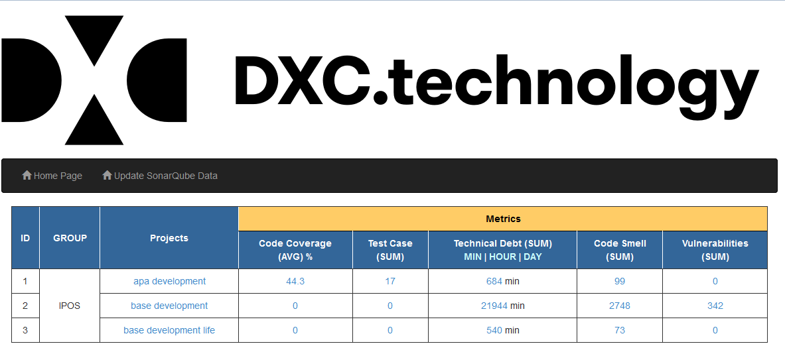
SonarQube System Report
Home Page

Slide 9
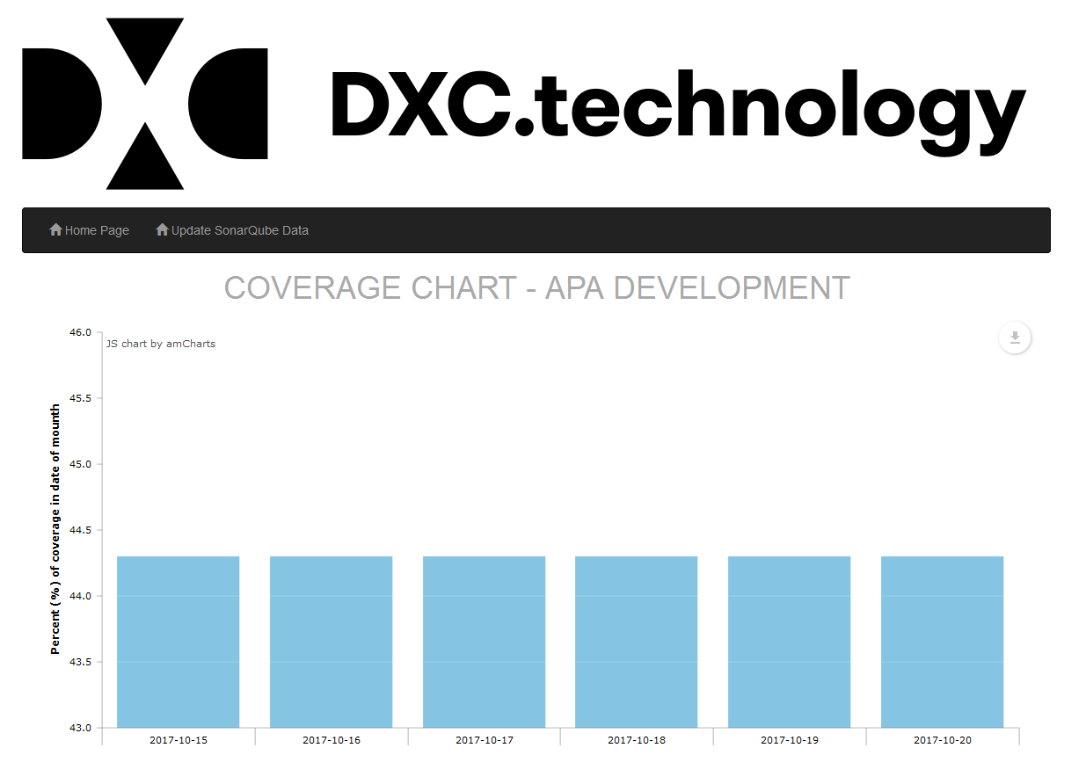
SonarQube System Report
Metrics Chart :
Horizontal : Day Updated
Vertical : Metric Unit
Download Chart Button

Slide 10
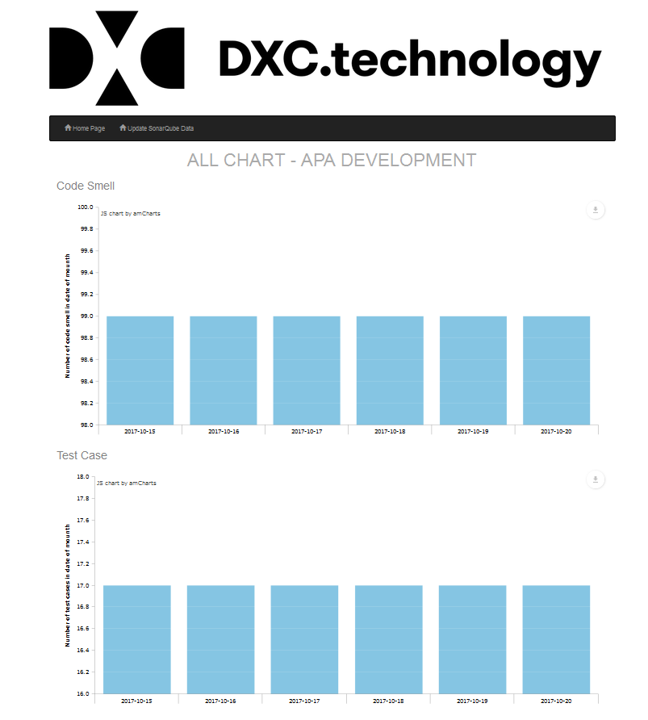
SonarQube System Report
Overral Project Chart :
Code Smell Chart (Sum)
Test Case Chart (Sum)
Technical Dept (Sum)
Vulnerabilities (Sum)
Code Coverage (%)

Slide 11
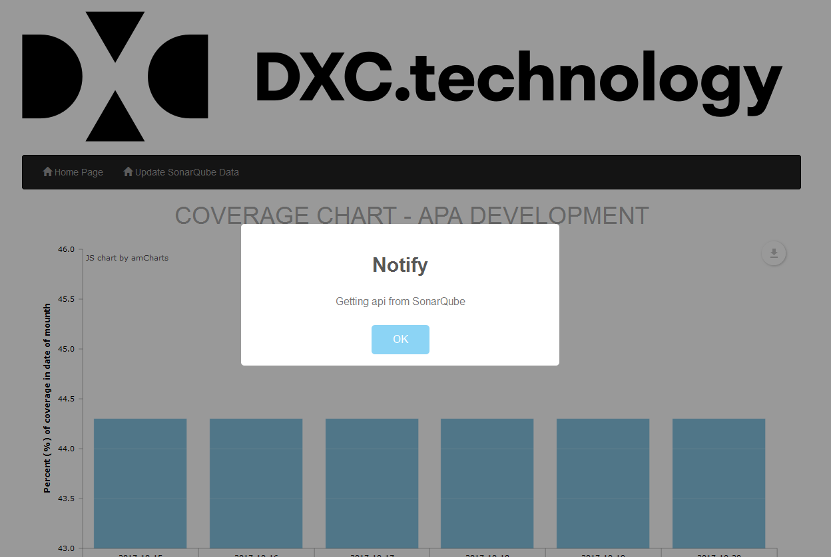
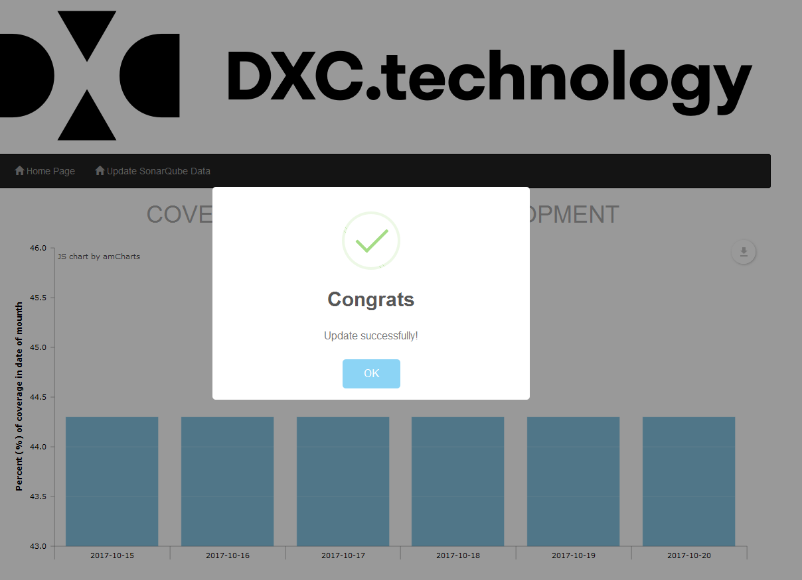
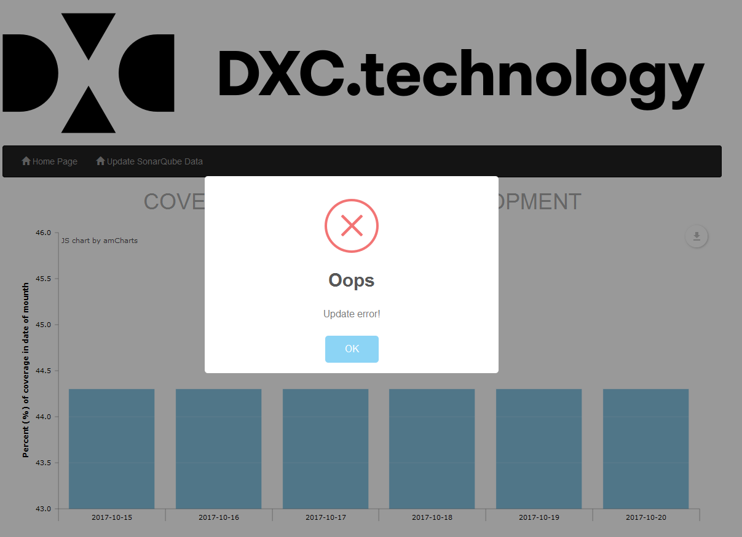
SonarQube System Report
Update Metrics :
Data Updating Data Update Successful Data Update Failed

Slide 12
System Architecture

Slide 13
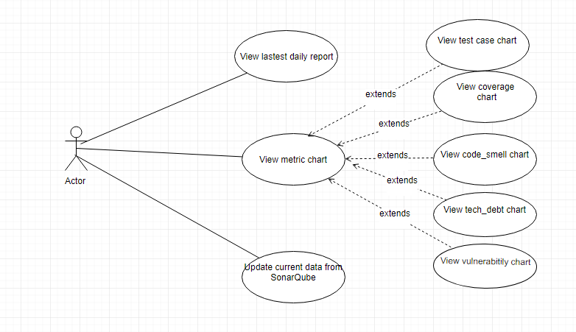
SonarQube System Report
USE CASE DIAGRAM

Slide 14
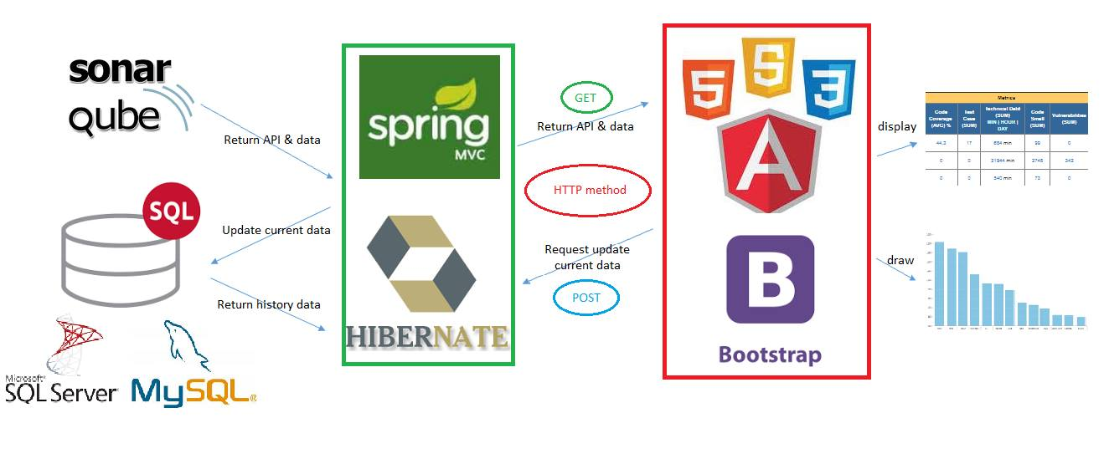
System Architecture
System Architecture:

Slide 15
About Requirement and SonarQube
Technology Used:
Server Side: Java(Framework : Spring MVC), Hibernate(SQL Server, MySQL).
Server: Apache tomcat 8
Client side: AngularJS, Bootstrap, HTML5/CSS3
Library : Arm Chart, Sweet Alert
Database: MySQL, SQL Server
IDE: Eclipse, Notepad++
Task: google drive
Source control: GitHub

Slide 16
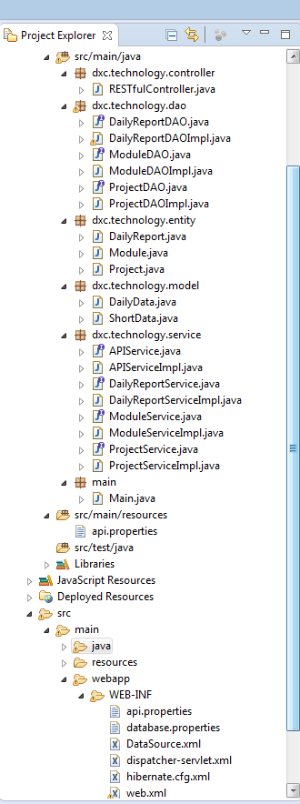
System Architecture
Server side

Slide 17
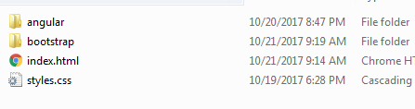
System Architecture
Client side

Slide 18
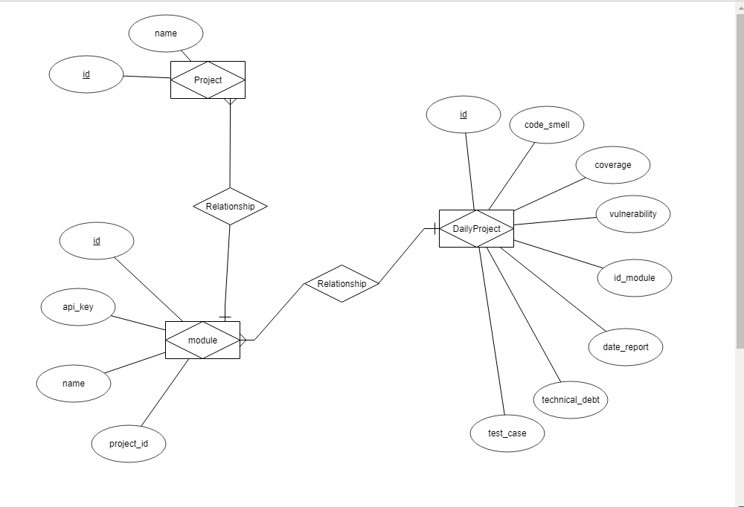
System Architecture

Slide 19
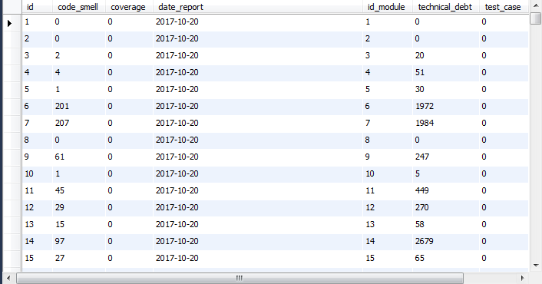
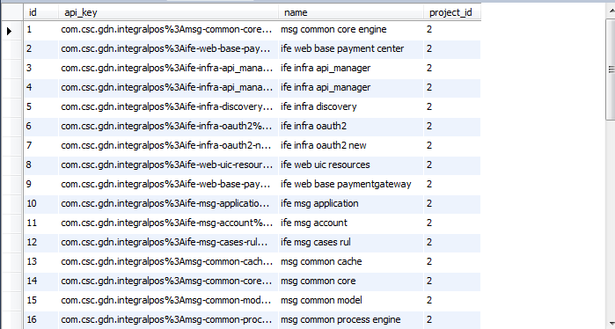
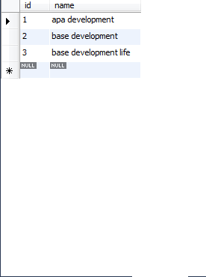
System Architecture
Daily Report Table Module Table Project Table

Slide 20
Project Demo

Slide 21
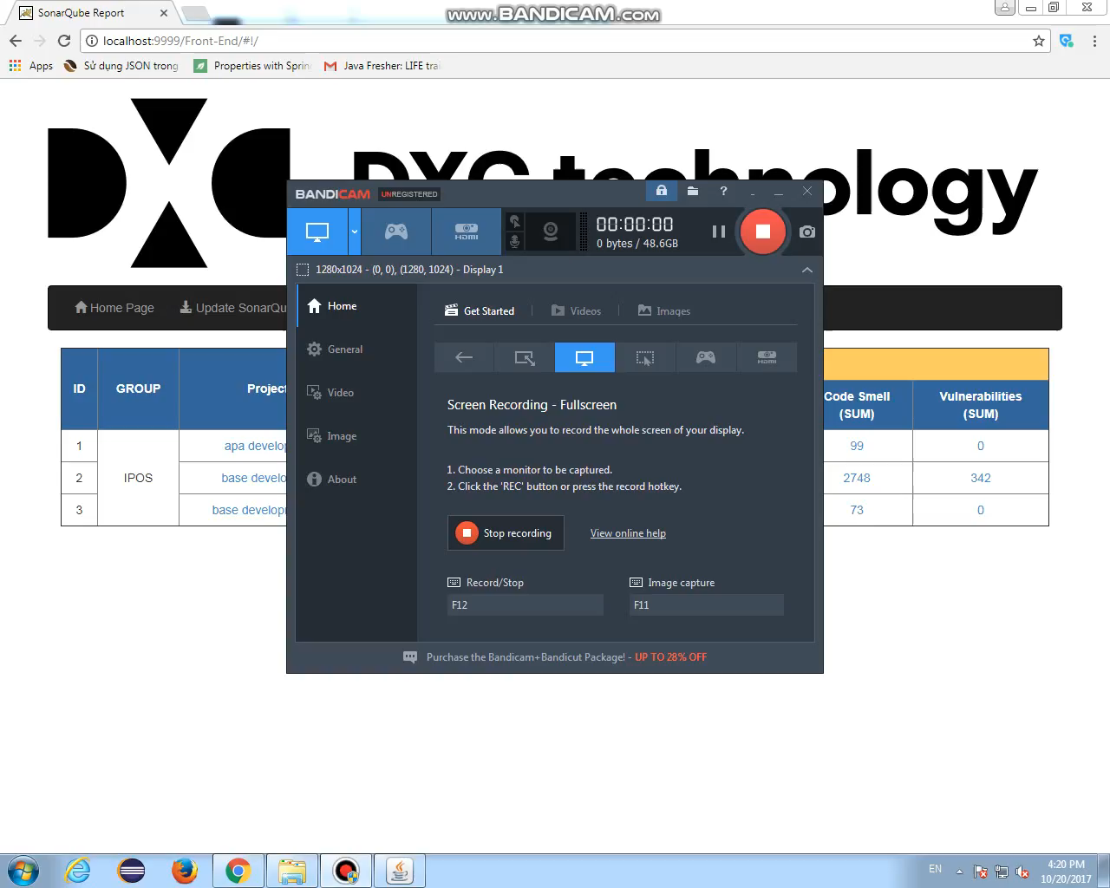

Slide 22
Question & Answer

Slide 23
Thank You <3

